Slide 1
Graduate School Information Session
Statistics & Probability Association (SPA) Presenting
Oct 20th 2011

Slide 2
PhD student, Kirk Li
Why?
What do you want from graduate school?
Knowledge?
School life?
Better job?
Soul-mate(s)?
Do you need it?

Slide 3
Which?
Which is for you? Master?
Pros for a Master degree:
1. Learn whatever interested/useful to you
2. One year and half
3. Then doing something else, a job or a Ph.D !
4. Easy...?
Are there any cons for a Master degree?
1. $$$$$$
2. LD

Slide 4
Which?
Which is for you? Ph.D?
Pros for a Ph.D degree:
1. Comprehensive learning process
2. Not ready for working? Life in research.
3. $$$$$$
4. A better job?
Are there any cons for a Ph.D degree?
1. 4-6 years
2. Hard...

Slide 5
How?
Understand your advantages
Understand the different programs
Some exams
A unique PS. CV.
Be good at ”Taocier”
BE PROFESSIONAL !

Slide 6
Questions?

Slide 7
Professor Marina Meila
MS or PhD?
[Why go to grad school?]
[About me]
What is expected of a PhD student?
(*) able to learn difficult material
(**) able to do research - use material
invent, be original
be curious
enjoy it all
be organized - there will be big demands on your time
writing/presentation skills/ collaboration/communication skills
language (if you are foreign)

Slide 8
How to choose a program; Research your universities
aim high - better/higher ranked is [generally] better
good fit with your area (of research)
home pages of professors
what are their declared areas of research
read/skim their papers
notice if they have students or not - where do their students go?
departmental pages on research topics, list of RA-ships for students
graduate requirements
find people you know who are now grad students - find out from them
are they well advised? happy?
how did they get in? what can they advise you?

Slide 9
Your application
Tests - prepare, take practice tests, don't overdo
GRE general - not very informative, unless you do poorly
subject test (Math, CS) - important for Math, CS, Physics?, Mech Eng
not informative for Stat, (EE??)(unless you do very well)

Slide 10
Letters - you need to have 3 people who like you and know you
Preferably to have done something more than classes with them
e.g RESEARCH PROJECT
their letters must convince admission committee that you have the qualities
when you do research project - FINISH IT (somehow), WRITE RESEARCH
REPORT and ASK FOR FEEDBACK
when you don't finish a research project - write to the
advisor, say sorry, [write up what you did, how far you got]
when someone accepts to write a letter for you
give them your CV (in the least), but better all your
application materials (statment,..)
give them a list of URL's where they must upload letters, labeleld envelopes, web page with all places/deadlines...
remind them when deadlines are coming
tell them afterwards if you were admitted or not

Slide 11
Statement
Must convince admission committee that you have the qualities * and **
your background, and what your are good at
only relevant to field you apply for
e.g "I have degrees in math and physics", "I majored in CS, but I've also taken courses in statistics" (say these things succintly, even if they also are in the CV, transcript)
concretely - did you win any competitions/awards
did you do exceptionally well in a class (make sure that the letter writer also says so), where you the top student (make sure that's supported by other materials)
research experience - with whom, what, was it published (mention that you have submitted the publication with the application)
describe what you did. what worked and what didn't. be technical. (e.g "this method didn't work because the variables were not independent", or "i didn't know how to solve this exactly, therefore I used simulated annealing. i implemented the code myself, except for the function XXX for which i used ...", or "i thought that this problem ressembles problem YYY from my course ZZZ, and i found code for that and compared it with the standard solution") take cca 1 paragraph per research project.

Slide 12
did you try some research of your own (without anyone giving you a topic? or advice?) write about it (also 1 paragraph)
other experience - only if relevant
as useful background
as motivator
computing/programming experience IS relevant
other special things about you (---> in the CV but not statement)
e.g "i rowed across the Pacific last summer“
"plans for your career" - mainly PhD or Master
"plans during grad studies"
yes, this is important - give the committee concrete info
areas of study and research, which professors you would like to work with (they will get your application to read)
concrete topics/ideas of research (if you have them)
these plans _are not binding_ (until you get an RA-ship)
they show how you think, with whom you'll best fit
this is good, because as you learn more, your ideas will change

Slide 13
Application - send your work if you have any
Publications
research PROJECT reports
websites you created (relevant only)
make sure it was received, included in your "packet“
(with Departmental admissions staff), or ask them how to send it

Slide 14
Questions?

Slide 15
PhD student, Roddy Theobald
Why statistics?
Research opportunities.
Specific internship opportunity.

Slide 16
measuring teacher quality and investigating teacher layoffs
Roddy Theobald
Department of Statistics
Center for Education Data & Research
www.cedr.us

Slide 17
How do you measure teacher quality?
Teacher quality is the most important schooling factor influencing student achievement
The teacher quality effect is roughly equivalent to lowering class size by 10 to 13 students
Inputs currently used to measure and evaluate teacher quality - licensure status, degree, experience level - are only weakly linked with teacher effectiveness (Goldhaber, 2002, 2007; Kane et al. 2006).

Slide 18
Teacher Quality Appears to be
Primarily “Unobservable”

Slide 19
Value-Added Modeling
Measures a teacher’s contribution to student gains on standardized test scores
i indexes student
j indexes teacher
k indexes student
s indexes subject
t indexes year

Slide 20
Value-Added Modeling
Measures a teacher’s contribution to student gains on standardized tests
Student covariates
Classroom covariates
Year effect
Student achievement in subject s in year t
Student achievement in subject s in year t-1
School covariates
Error term
TEACHER EFFECT
This gives time-invariant measure of teacher effectiveness relative to all other teachers

Slide 21
Layoff Study (Goldhaber and Theobald 2011, in review at JPAM, policy version published in Education Next)
In Washington State in 2008-09 and 2009-10, 2094 teachers received reduction-in-force (RIF) notices
The vast majority were first- or second-year teachers, since most collective bargaining agreements mandate that layoff notices be delivered in reverse order of seniority
For teachers in grades 4-6, we can link data on these layoff notices to student test score data to calculate VAM estimates of effectiveness

Slide 22
Distribution of Teacher Effectiveness

Slide 23
Distribution of Teacher Effectiveness
Difference of 5.6% of a standard deviation of student performance

Slide 24
Simulation of effectiveness-based layoffs
We simulate effectiveness-based layoffs for the subset of teachers linked to student data
We calculate a pooled-year value-added (VAM) estimate for each teacher in both math and reading
We average these estimates across both subjects
Within each district, teachers are ranked by effectiveness
Again within each district, starting with the least effective teacher, enough teachers are assigned to a hypothetical layoff pool to achieve a budgetary savings at least as great as that district would have achieved had all teachers who received a RIF notice actually been laid off.

Slide 25
Distribution of Teacher Effectiveness
Difference of 5.6% of a standard deviation of student performance
Difference of 5.6% of a standard deviation of student performance

Slide 26
Distribution of Teacher Effectiveness
Difference of 5.6% of a standard deviation of student performance
Difference of 20% of a standard deviation of student performance

Slide 27
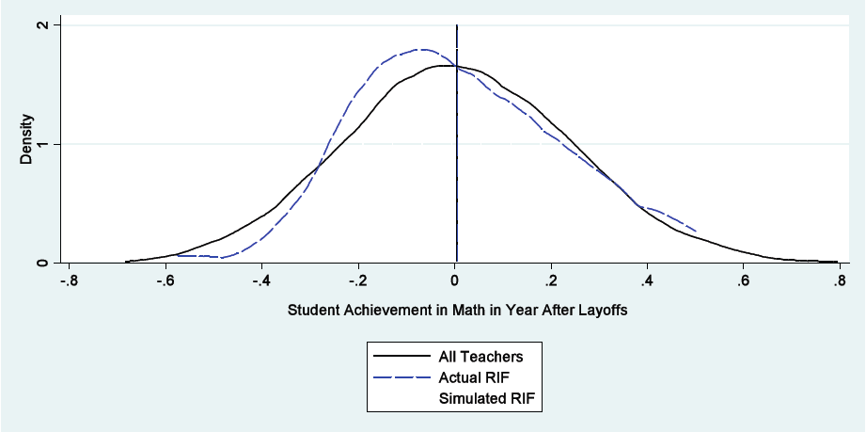
What about the following year?
No difference in average effectiveness

Slide 28
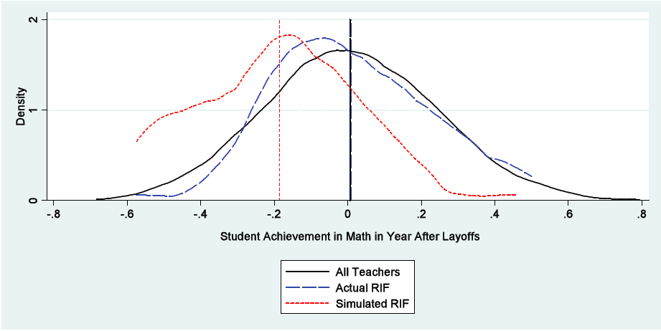
What about the following year?
Difference of 19% of a standard deviation of student performance

Slide 29
Conclusions
The difference that persists in the year following the layoffs is substantial
The difference between the average effectiveness of teachers actually laid-off and teachers laid-off in our simulation is equivalent to 2-3 months of student learning
There are good reasons to consider seniority in layoff decisions, but using seniority as the primary determinant of teacher layoffs has consequences for student achievement

Slide 30
Acknowledgements
At CEDR
Dan Goldhaber, director and PI
Stephanie Liddle
Steve Dieterle
Scott DeBurgomaster
Jordan Chamberlain
Funding
The Gates Foundation
The American Enterprise Institute
CALDER
Institute for Education Sciences

Slide 31
Backup Slides

Slide 32
Q2: Implications of RIF Notices

Slide 33
Marginal Effects: Linear effects
Notes:
JUST PASTE IN THE TABLE

Slide 34
Marginal Effects: Non-linear effects
Notes:
JUST PASTE IN THE TABLE

Slide 35
Marginal Effects: Including effectiveness
Notes:
JUST PASTE IN THE TABLE

Slide 36
Questions?

Slide 37
Thank you!
Joining SPA?
http://students.washington.edu/spassc
Or just contact one of our officers NOW!
We would be happy to have you!
For stat 394 students, your report is due on Oct 27th 11:00 pm
Catalyst drop box is open now:
https://catalyst.uw.edu/collectit/dropbox/summary/xuran/18181
Any further questions, feel free to contact any of us!

